Slide 1
Measuring Evolutionary Constraint:
Non-Coding RNA
Caleb Radens

Slide 2
Mechanisms of Evolution
Selection
Mutation
Migration
Drift

Slide 3
Mechanisms of Evolution
(simplified)
Selection
Everything Else

Slide 4
Mechanisms of Evolution
(simplified)
Selection
Everything else
Types of mutations:
  SNV
  In/Del
  Duplication
  Repeat expansion
  Etc...

Slide 5
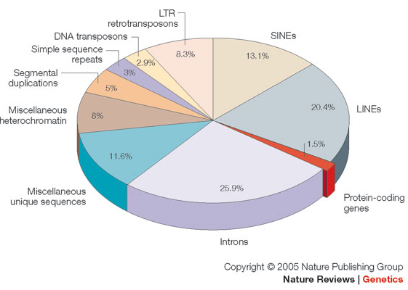
Mechanisms of Evolution
(simplified)
Selection
Everything else
Types of mutations:
  SNV
  In/Del
  Duplication
  Repeat expansion
  Etc...

Slide 6
Probability of observing a SNV?

Slide 7
Probability of observing a SNV?

Slide 8
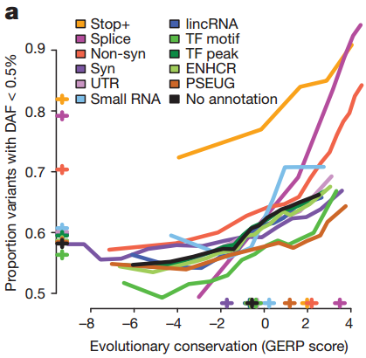
Selection and SNVs

Slide 9
Sequence Context Models for Substitution Probabilities
1-mer
C->C [0.9]
C->G [0.025]
C->T [0.05]
C->A [0.025]
Etc...
2-mer
AC->AC [0.9]
AC->AG [0.005]
AC->AA [0.005]
AC->AT [0.01]
Etc... [0.08]

Slide 10
7-mer Sequence Context Model
NNN[C]NNN → NNN[A/T/C/G]NNN
“...we demonstrate that a heptanucleotide context explains >81% variability in substitution probabilities...”

Slide 11
Probability of observing a SNV?
What is important?
Sequence context
Location in Genome
  Conservation of LD block
  Coding vs Non-Coding

Slide 12
Hypotheses
Some lincRNA are known to be functional
  Sequence is important
LincRNA should should show biological constraint
As should miRNA (and other classes)

